Slide 1
CE 331 LAB REPORT MONDAY group 2
Lead By: Group Members:
RAHUL KUMAR (200755)
Prof. BALAJI DEVARAJU RAHUL YADAV (200759)
ONKAR DIKSHIT RAJAT SAHU (200765)
RAJU KUMAR ( 200765)
RITIK RAJ (200804)

Slide 2
ACKNOWLEDGEMENT
We would like to express my gratitude to our course instructor Dr. Balaji Devaraju and Dr. Onkar Dikshit, our lab staff Mr. Shitla Prasad Tripathi and Mr. Hari Babu for providing support and guidance for the completion of our project. We would also like to thank our tutor Ibaad Anwar and all the TAs for his time and efforts in our project

Slide 3
introduction
In any civil engineering work, surveying is one of the most basic and important process, surveying is the technique to determine relative position of different features above and below the surface of earth. Without surveying we cannot even initiate the work, so surveying is basic block of functioning of all civil engineering works. We mapped the area from GI Lab to Faculty building and then from faculty building to Mechanical building

Slide 4
OBJECTIVES
This report focus on how to map a given area using machines like GNSS , EDMI, TOTAL STATION, THEODOLITE ,how to mathematically calculate error in measurement of angles and sides of loop and then resolve them . The main objective is how to collect field data points using traverse technique and how to plot these detail using software
METHODOLOGY:-

Slide 5
WEEK 1
RECONNAISSANCE
Performed reconnaissance survey of the given area to ;
Identify appropriate path/route for the given area (covering as much details as possible and eliminating those which are unfeasible)
Then marking sufficient number of control point
To make sure the inter-visibility of the control point and make close loop for traversing

Slide 6
MAP

Slide 7
WEEK 2
TRAVERSING AND ANGLE MEASUREMENT
After identifying the control point, the next thing is we measured the distance and internal angle of traverse loop .
We measured the distance between control points and interior angle of the loop formed using total station
And there was closing error in measuring distance, which we adjusted according to Bowditch rule

Slide 8
TOTAL ERROR= ((-1.866)^2+(5.624)^2)^0.5
Line | Latitude (m) | Departure (m)
AB | 28.671 | 162.602
BC | -82.962 | 17.634
CD | -15.002 | -15.002
DE | -28.143 | -159.61
EA | 95.970 | 0
 | SUMMATION=-1.866 | SUMMATION=5.624
line | Correction in Latitude (m) | Corrected Latitude (m) | Correction in Departure (m) | Corrected Departure (m)
AB | 0.582 | 29.253 | -1.756 | 160.846
BC | 0.299 | -82.662 | -0.902 | 16.731
CD | 0.074 | -14.927 | -0.211 | -15.213
DE | 0.571 | -27.571 | -1.723 | -161.33
EA | 0.337 | 95.907 | -1.016 | -1.016

Slide 9
SUM OF ANGLES = 539.99 DEGREE MISCLOUSRE ERROR E= 5.925 SO 3<E<6 D= 0.528786 KM E*DISTANCE^0.5 =2.2782 QUALITY OF WORK = HIGHLY PRECISION
Sides | Distance (m)
AB | 165.111
BC | 84.816
CD | 21.216
DE | 162.073
EA | 95.570
Internal angle | Measurement (degree)
A | 97 47 29
B | 91 08 08
C | 122 28 16
D | 145 46 15
E | 82 49 48

Slide 10
WEEK 3
LEVELLING
We find the reduced level of the given control points with the help of auto leveller and prism.
We measured the elevation of control points with reference to GI lab as bench mark
The loop error was then corrected to bowditch rule

Slide 11
SUM OF BS-SUM OF FS=0.004 CHANGE IN RL= 0.004 ERROR = 0.004
Station | B.S (m) | F.S (m) | H.I (m) | RL (m)
O | 1.188 |  | 129.597 | 128.409
E | 1.559 | 1.442 | 129.714 | 128.155
A | 1.442 | 1.858 | 129.298 | 127.856
A’ | 1.495 | 1.318 | 129.475 | 127.980
B | 1.558 | 1.583 | 129.450 | 127.892
C | 1.605 | 1.695 | 129.360 | 127.755
D | 1.941 | 1.582 | 129.719 | 127.778
D’ | 1.558 | 1.610 | 129.667 | 128.109
E | 1.711 | 1.505 | 129.873 | 128.162
O |  | 1.460 |  | 128.413
 | Sum of BS=14.057 | Sum of FS= 14.053 |  | Change in RL=0.004

Slide 12
Error in each station= ei= -E*di/D
ei = error at i station
D = total perimeter
di= distance of i station from benchmark
E= total closing error
Stations | Corrected RL (m)
O | 128.409
E | 128.1546
A | 127.8552
A’ | 127.9786
B | 127.8902
C | 127.7528
D’ | 128.1059
E | 128.1585
O | 128.409

Slide 13
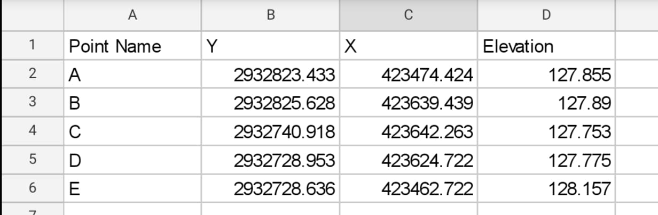
WEEK 4
We used GNSS machines to obtain global coordinate of all the 5 control points

Slide 14
WEEK 5
We mapped different features like poles, trees, contour lines, building using total station
WEEK 6
We exported the data from tata station and with the help of these point we prepared map on QGIS

Slide 15
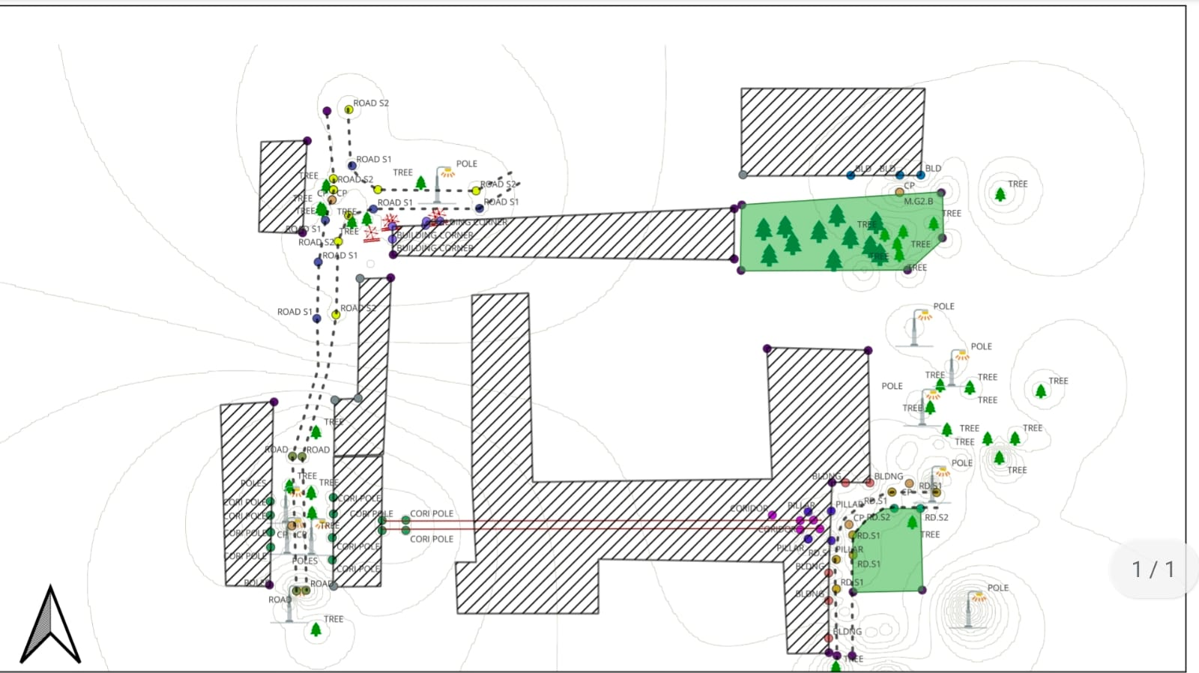
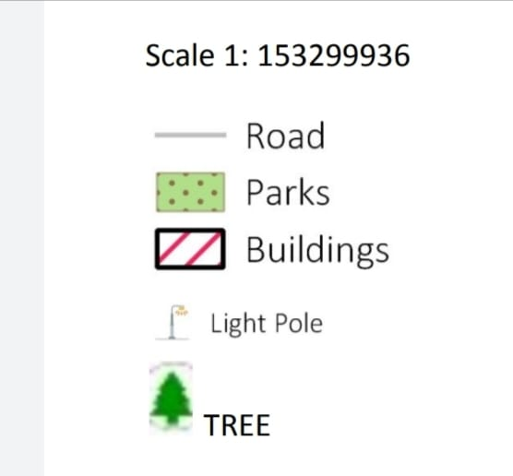

Slide 16
THANK YOU

